Slide 1
Customer Personality Analysis
& Customer Segmentation Project
Final Presentation — AI Lab 99 Machine Learning Internship
Modules 1-11 · Data Cleaning to Deployed Dashboard

Slide 2
Business Problem
2,237 customers, no systematic way to group them into actionable segments
Marketing spend, discounting, and retention are applied uniformly, not targeted
Budget is wasted on low-response segments while high-value customers are under-served
No live tool exists for the business to look up or classify customers on demand
AI Lab 99 — Customer Segmentation Project
2

Slide 3
Project Objectives
Clean and validate the raw dataset end-to-end
Engineer behaviourally meaningful features
Train, compare, and select the best clustering algorithm
Translate clusters into named, business-actionable segments
Ship a tested, documented, interactive dashboard application
AI Lab 99 — Customer Segmentation Project
3

Slide 4
Dataset Overview
Customer Personality Analysis dataset (Kaggle)
2,240 → 2,237
29 → 67
215 KB
6
Rows (raw → cleaned)
Columns (raw → final)
Raw file size
Product categories tracked
Demographics, purchasing behaviour across 4 channels, responses to 6 marketing campaigns, complaints, and website engagement.
AI Lab 99 — Customer Segmentation Project
4

Slide 5
Data Quality & Preprocessing
24 missing Income values → median imputation (right-skewed distribution)
3 customers with implausible ages (>100 yrs) → removed
Inconsistent categories ("Alone", "Absurd", "YOLO") → standardized
Income outliers → capped (winsorized); spending outliers kept as genuine behaviour
StandardScaler selected for the final clustering feature set
AI Lab 99 — Customer Segmentation Project
5

Slide 6
EDA Findings
Customers average 57 years old, $51,855 income (right-skewed)
Wine is the highest-revenue product category across the entire base
Store purchases are the most-used channel, ahead of web and catalogue
The latest campaign hit 14.9% acceptance — 2x any prior campaign
Income and Total Spend correlate strongly (r ≈ 0.80)
AI Lab 99 — Customer Segmentation Project
6

Slide 7
Feature Engineering
13 new behavioural features created
Customer_Age
Customer_Tenure
Total_Spending
Total_Purchases
Digital_Engagement
Deal_Dependency
+ 7 more: Total_Children, Family_Size, Total_Campaign_Acceptance, Avg_Spending_Per_Purchase, Preferred_Shopping_Channel, Product_Preference, Customer_Activity_Level
AI Lab 99 — Customer Segmentation Project
7

Slide 8
ML Algorithms Tested
Four clustering algorithms compared head-to-head
Algorithm | Silhouette | Davies-Bouldin | Time (s)
K-Means (selected) | 0.169 | 1.890 | 0.017
Hierarchical | 0.139 | 1.805 | 0.166
GMM | 0.048 | 2.918 | 0.094
DBSCAN | N/A | N/A | 0.128
AI Lab 99 — Customer Segmentation Project
8

Slide 9
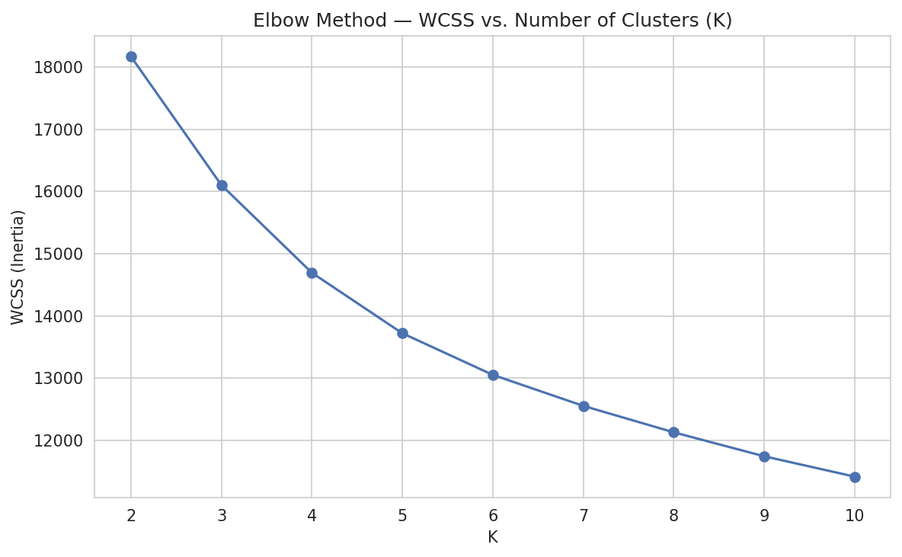
Model Evaluation & K Selection
Balancing statistical optimum with business usability
K=2 statistically optimal
...but too coarse for named personas
K=4 chosen — business-driven override
Stability: ARI > 0.95 across seeds/bootstrap
AI Lab 99 — Customer Segmentation Project
9

Slide 10
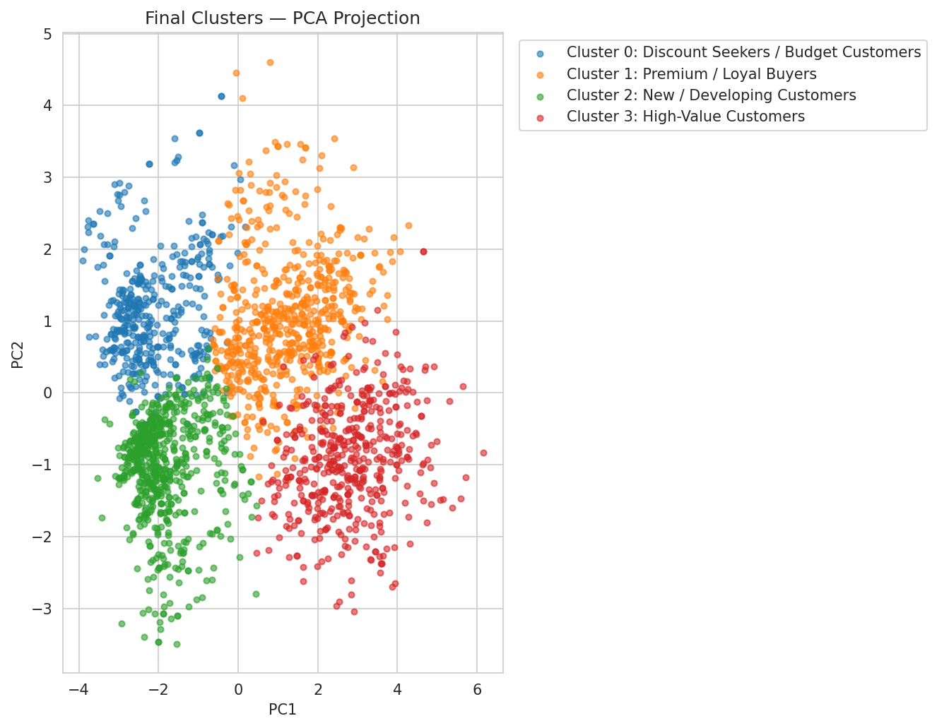
Customer Segments
4 named, business-actionable segments
High-Value (22.1%)
Premium/Loyal (28.6%)
Discount Seekers (19.1%)
New/Developing (30.2%)
AI Lab 99 — Customer Segmentation Project
10

Slide 11
Business & Marketing Recommendations
High-Value: low-frequency VIP campaigns, premium bundles, early access
Premium/Loyal: increase campaign investment to match high engagement
Discount Seekers: value-led bundles via SMS/Email, avoid premium messaging
New/Developing: structured 30-60 day onboarding to build habits
1,103 customers flagged across all segments for reactivation campaigns
AI Lab 99 — Customer Segmentation Project
11

Slide 12
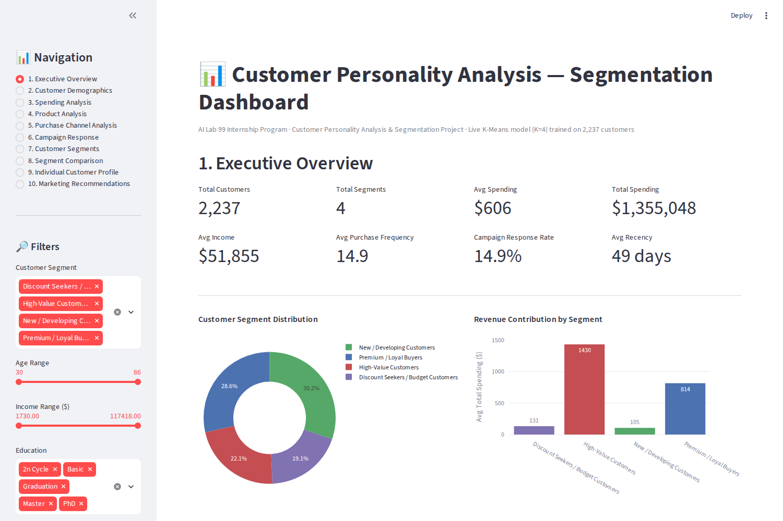
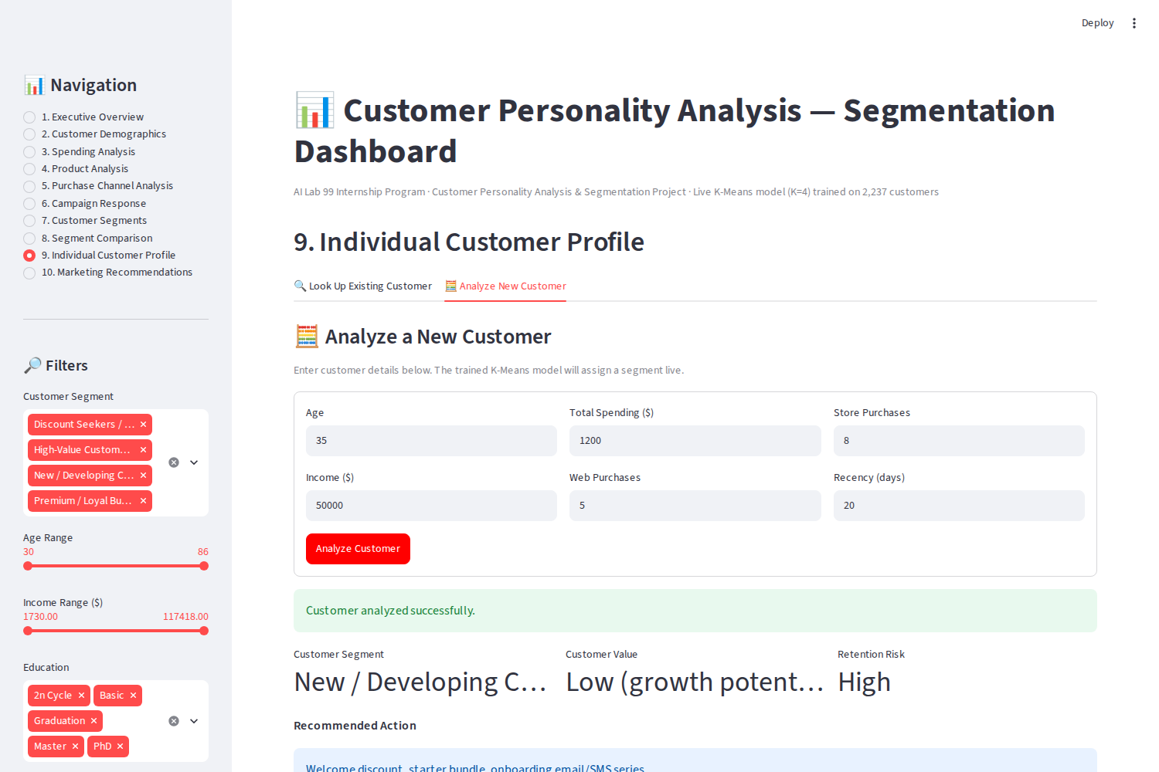
Interactive Dashboard
Live K-Means model, 10 sections, 8 filters
AI Lab 99 — Customer Segmentation Project
12

Slide 13
Testing & QA
40 automated tests, 100% pass rate
40/40
3
0
Pytest tests passing
Defects found & fixed
Open defects at ship
Data validation · Preprocessing · Feature engineering · Model · Dashboard UI · UAT · Regression
AI Lab 99 — Customer Segmentation Project
13

Slide 14
Limitations & Future Scope
Static dataset snapshot — no real-time data integration yet
K=4 was a business judgment call, not the pure statistical optimum
Future: churn prediction, CLV modelling, automated retraining, cloud deployment
Future: real-time campaign integration with CRM/ESP systems
AI Lab 99 — Customer Segmentation Project
14

Slide 15
Conclusion
A complete, tested, documented ML application — from raw data to a live dashboard. 22.1% of customers (High-Value) generate 52.2% of revenue, while the largest segment (New/Developing, 30.2%) is the biggest growth opportunity. The strategy matrix and dashboard are ready to guide marketing decisions today.
Thank you
AI Lab 99 — Customer Segmentation Project
15

